Slide 1

AtliQ Hospitality Analysis
Sreehari PK

Slide 2
Problem Statement
AtliQ Grands owns multiple five-star hotels across India. They have been in the hospitality industry for the past 20 years. Due to strategic moves from other competitors and ineffective decision-making in management, AtliQ Grands are losing its market share and revenue in the luxury/business hotels category

Slide 3
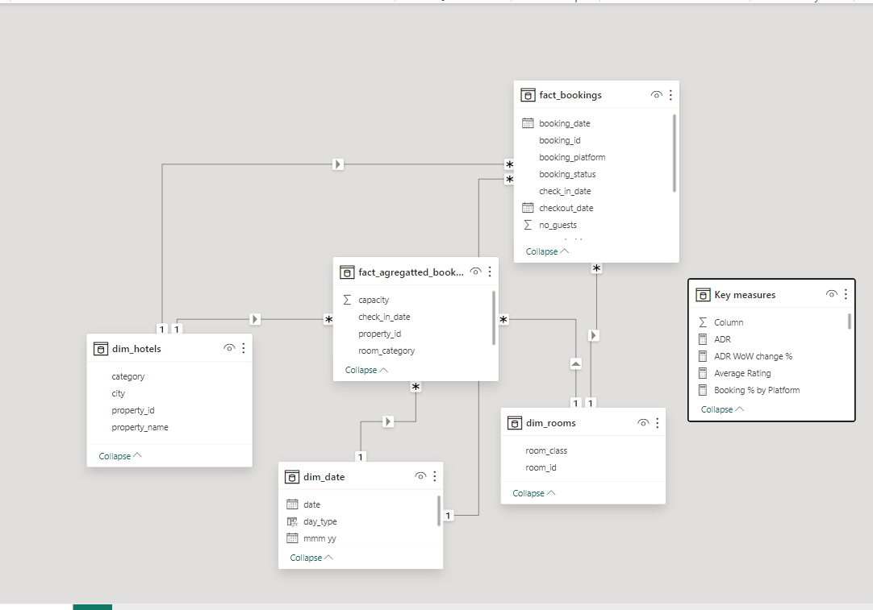
Data Model

Slide 4
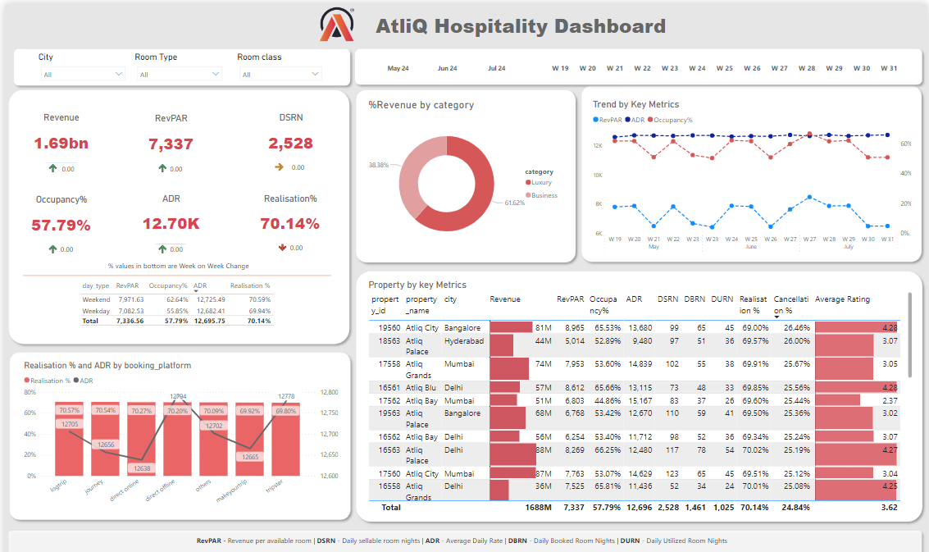
Dashboard

Slide 5
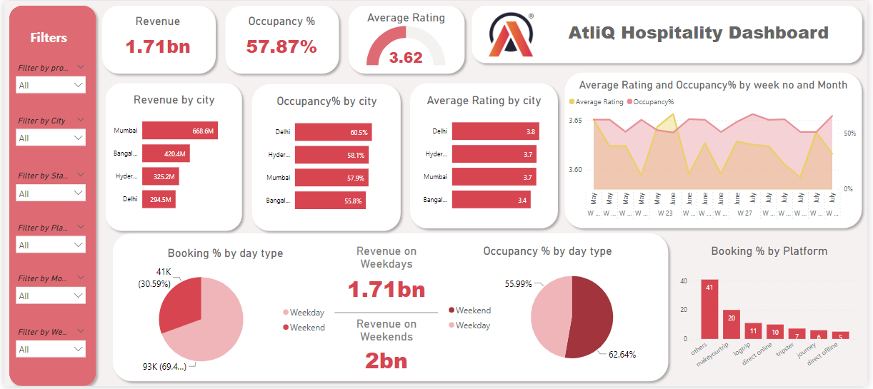
Dashboard

Slide 6
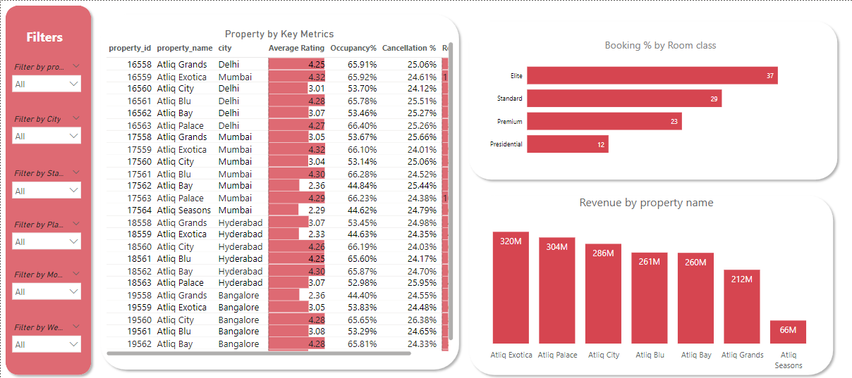
Dashboard

Slide 7
Insights
Mumbai generates the highest revenue (661 M) followed by Bangalore, Hyderabad and Delhi
AtliQ Exotica performs better compared to all 7 type of properties with 316 Million revenue, rating 3.6, occupancy percentage 57.2 % and cancellation rate as 24.4%
AtliQ Blu has the highest occupancy of 61.9 %
Week 29 recorded the highest revenue among all, which is 139.7 Million
Delhi tops both in occupancy and rating followed by Hyderabad, Mumbai, Bangalore
AtliQ lost around 300 Million in cancellation
Elite type rooms has the most booking and as well higher cancellation rate

Slide 8
Summary
These insights are not just numbers; they are the roadmap to revitalizing AtliQ Grands' revenue strategy. With Mumbai as a revenue stronghold and Delhi as a top-rated city, targeted marketing efforts can be focused here. The popularity of Elite rooms suggests a need for tailored promotions, while Makeyourtrip's dominance points to a lucrative partnership opportunity.
AtliQ Exotica's stellar performance highlights the potential for replication across other properties, leveraging data from the fact_aggregated_bookings table. Moreover, optimizing ADR at AtliQ Blu can further boost revenue.
In conclusion, data intelligence has unlocked a world of possibilities for AtliQ Grands. By leveraging these insights, the hotel chain can regain its competitive edge and secure its position as a leader in the luxury/business hotels category.
This is not just a project; it's a success story in the making, driven by data and innovation.

Slide 9
Thank You

